Slide 1

G
Quantum Computing — Michele Grossi
IBMQ Ambassador
Qiskit Advocate
T₀

Slide 2
“I’m not happy with all the analyses that go with just the classical theory, because nature isn’t classical, dammit, and if you want to make a simulation of nature, you’d better make it quantum mechanical …” Richard P. Feynman Department of Physics, California Institute of Technology International Journal of Theoretical Physics, Vol 21, Nos. 6/7, 1982
G
A
T₁

Slide 3
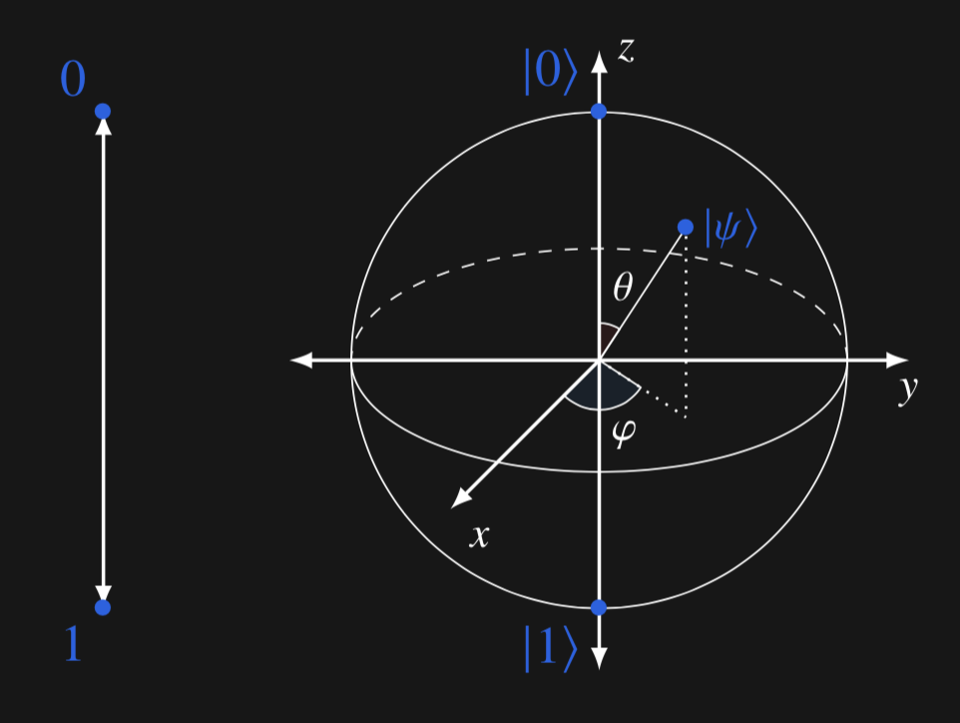
Quantum computing uses essential ideas from quantum mechanics
Superposition is creating a quantum state that is a combination of |0> and |1>.
Measurement is an action that forces a qubit to either |0> or |1> based on probability.
Entanglement strongly connects two or more qubits so that their quantum states are no longer independent.
Quantum gates perform the basic computational operations on qubits (think of as counterparts to classical and, +, and so on).
Interference allows us to increase the probability of getting the right answer and decrease the chance of getting the wrong one.
A
T₁
Notes:
Image: https://commons.wikimedia.org/wiki/File:Earth_from_Space.jpg
This file is in the public domain in the United States because it was solely created by NASA. NASA copyright policy states that "NASA material is not protected by copyright unless noted".

Slide 4
The hardware in an IBM Q quantum computing system
G
B
D
A
T₀
T₁
T₂

Slide 5
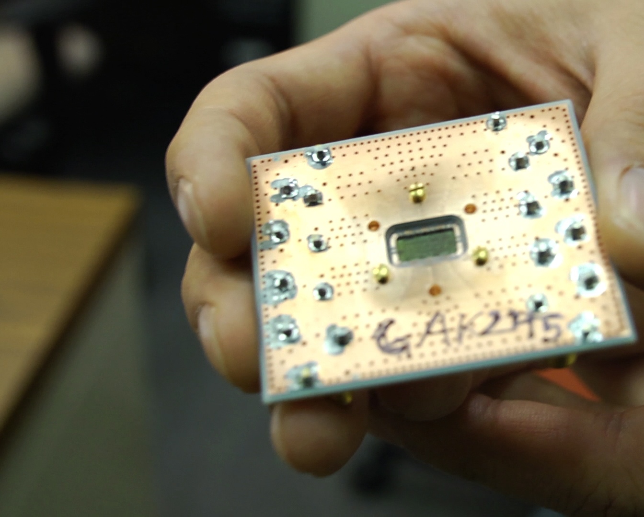
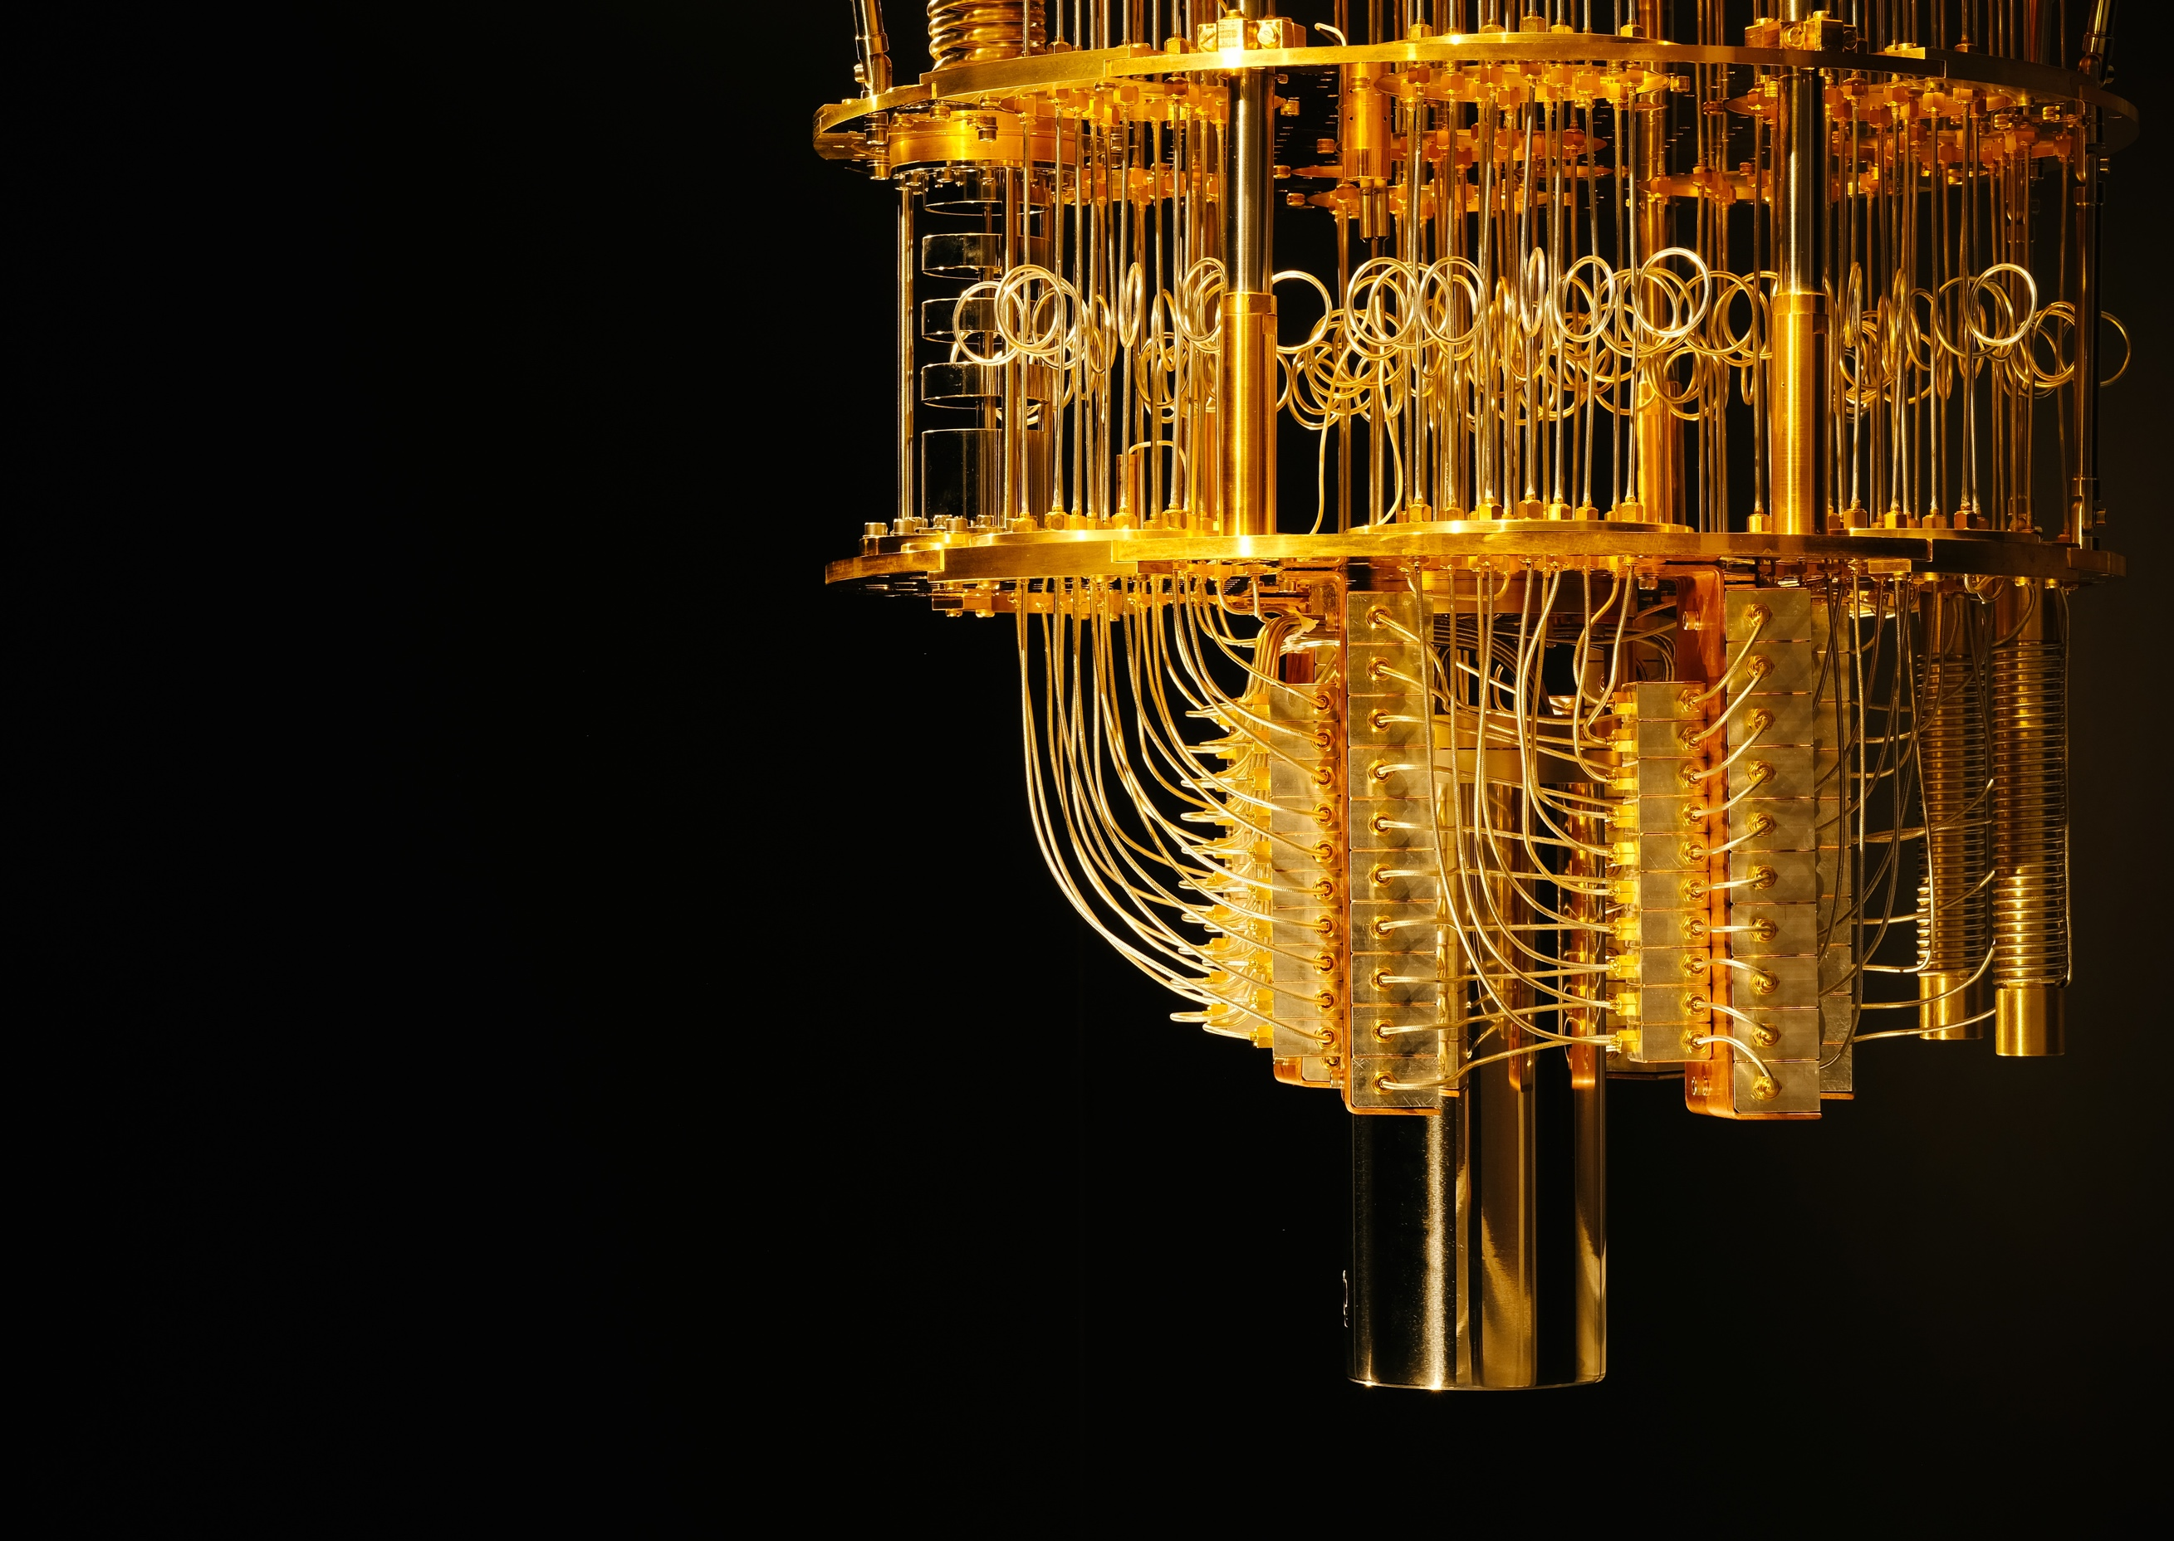
G
T₀
5

Slide 6
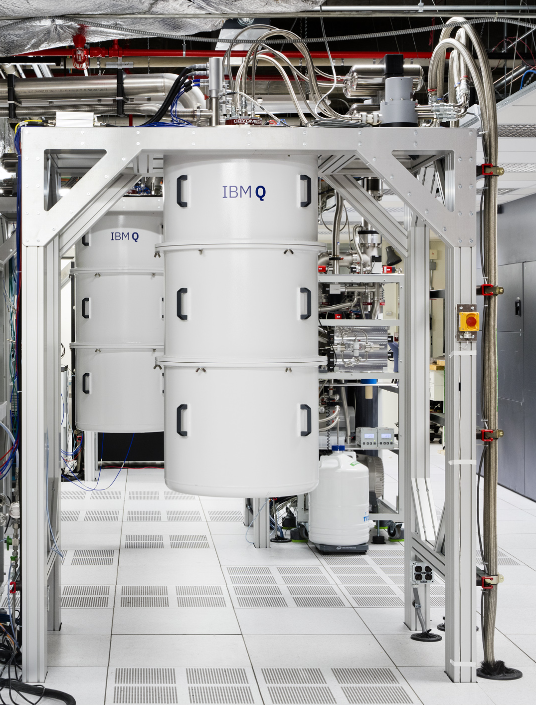
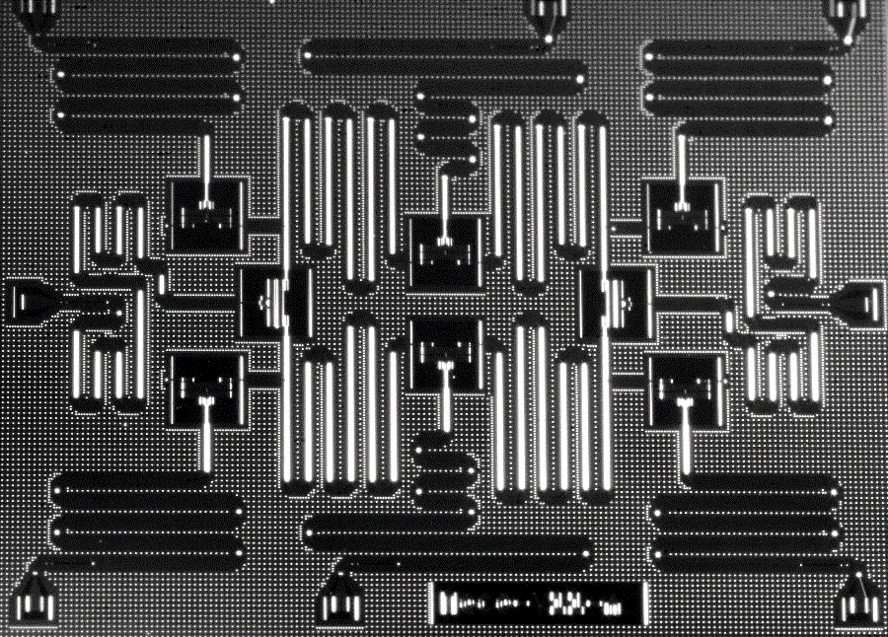
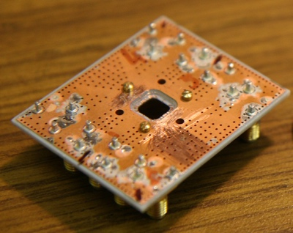
Inside an IBM Q quantum computing system
G
T₁
Qubits on chip
15 mK
Circuit board

Slide 7
How can we measure progress?
G
T₀

Slide 8
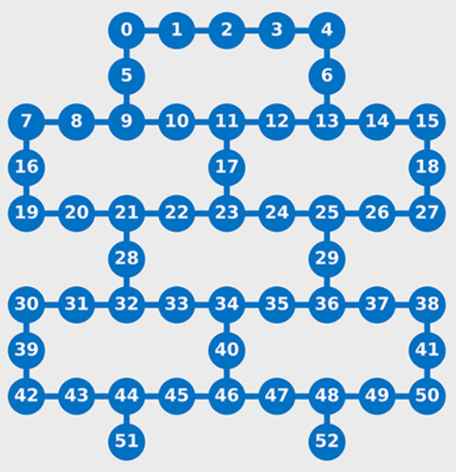
Quantum volume Many factors contribute to the performance of the overall system
G
Quantum Volume
calibration errors
circuit optimization
coherence
measure-ment fidelity
crosstalk
gate fidelity
gate parallelism
initialization fidelity
coupling map
spectator errors
number of qubits
Software!
T₁
Notes:
calibration errors
How well the electronic controls for programming and measuring qubits are calibrated to ensure accurate accurate operation and error mitigation.
circuit optimization
How well an optimizing compiler improves the layout and performance of a circuit across its depth and qubit register width.
coherence
How long the qubit stays in a usable state as discussed in section 11.4.
connectivity and coupling map
How qubits are connected to other qubits and in what patterns.
crosstalk
How the state of one qubit affects nearby qubits, either in gate operations or through more passive entanglement.
gate fidelity
At what error rates do gate operations move qubits from their current to new states.
gate parallelism
How many gate operations can be run on qubits in parallel, that is, at the same time. This is different from the concept of quantum parallelism.
initialization fidelity
How accurately we can set the initial qubit state to something known, usually |0⟩.
measurement fidelity
How accurately we can collapse a qubit state and read it out as |0⟩ or |1⟩. number of qubits
More can be better, but not always. In any case, you need a sufficient number.
spectator errors
How much is a qubit that is supposed to be idle affected during a 1- or 2-qubit gate operation on a physically connected qubit.

Slide 9
Inside an IBM Q quantum computing system VIDEO!!!
G
T₁

Slide 10
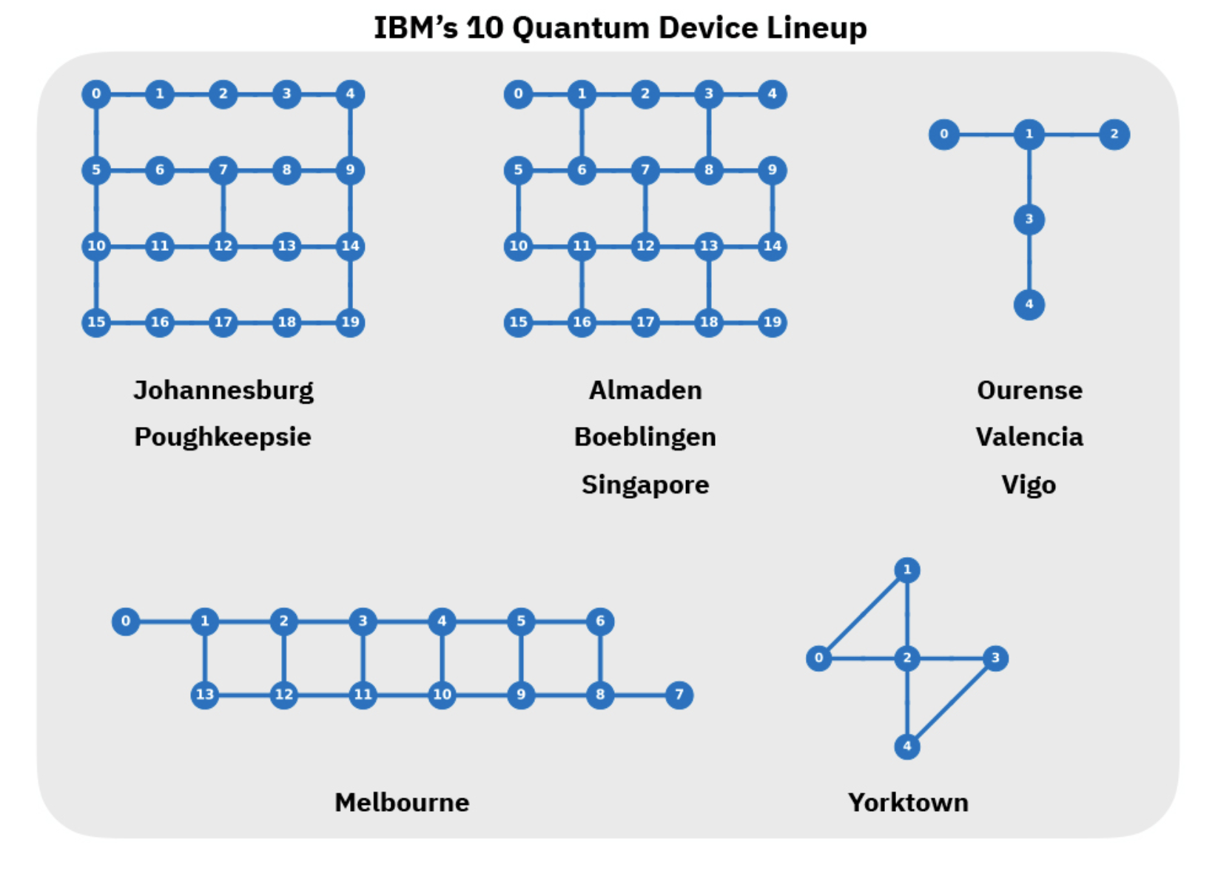
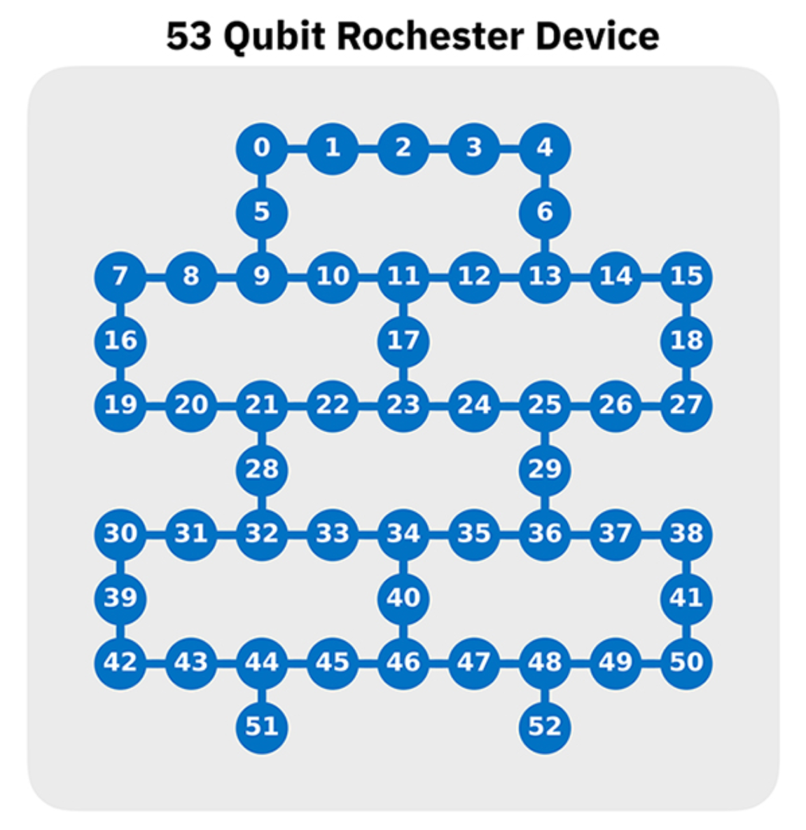
IBM Q quantum devices
D
A
T₀

Slide 11

We are building the quantum computation centers of the future with the IBM Q System One
G
B
T₀
Designed by IBM scientists, systems engineers, and industrial designers, IBM Q System One has a sophisticated, modular, and compact design optimized for stability, reliability, and continuous commercial use.
11

Slide 12

Using and writing software for an IBM Q quantum computing system
G
D
A
T₀

Slide 13

IBM Q Experience is the quantum cloud services and software platform designed to take full advantage of IBM Q systems.
G
D
A
T₀

Slide 14
The IBM Q Experience has been the most widely used and accessible quantum cloud service for business and science
G
D
A
1
First quantum computing system on the cloud in 2016. Several IBM Q systems are available to clients and the public. Over 155k users.
2
Release of open specifications for quantum cloud APIs has enabled the growth of Qiskit with over 240k downloads to date.
3
Real research is happening with the IBM Q Experience. Quantum community published 200 third-party papers testing fundamentals of science citing access to IBM Q tools.
4
An inflection point - users see more value in working with hardware than simulators as measured by the number of executions on each. Over 29 million experiments have run on IBM Q Experience.
T₀
Notes:
Statistics as of September 17, 2019

Slide 15
IBM Q Experience
Circuit Composer
Qiskit Notebooks
Seamless Experience
D
Build complex circuits.
Visualization tools provide different ways to view, run, and debug your circuits.
Edit code and watch your circuit change in real time.
Program with Qiskit notebooks powered by Jupyter technology integrated into our platform.
Import your current desktop notebooks into the cloud.
Qiskit provides all the quantum development tools you need.
Manage all your accounts and experiments in one place.
Pick up where you last left off with your work automatically saved on the cloud.
Grow your knowledge in quantum computing with tailored guides.
A
T₀
15

Slide 16
IBM Q Experience
Circuit Composer
Qiskit Notebooks
Seamless Experience
D
Build complex circuits.
Visualization tools provide different ways to view, run, and debug your circuits.
Edit code and watch your circuit change in real time.
Program with Qiskit notebooks powered by Jupyter technology integrated into our platform.
Import your current desktop notebooks into the cloud.
Qiskit provides all the quantum development tools you need.
Manage all your accounts and experiments in one place.
Pick up where you last left off with your work automatically saved on the cloud.
Grow your knowledge in quantum computing with tailored guides.
A
T₀
16

Slide 17
IBM Q Experience
Circuit Composer
Qiskit Notebooks
Seamless Experience
D
Build complex circuits.
Visualization tools provide different ways to view, run, and debug your circuits.
Edit code and watch your circuit change in real time.
Program with Qiskit notebooks powered by Jupyter technology integrated into our platform.
Import your current desktop notebooks into the cloud.
Qiskit provides all the quantum development tools you need.
Manage all your accounts and experiments in one place.
Pick up where you last left off with your work automatically saved on the cloud.
Grow your knowledge in quantum computing with tailored guides.
A
T₀
17

Slide 18
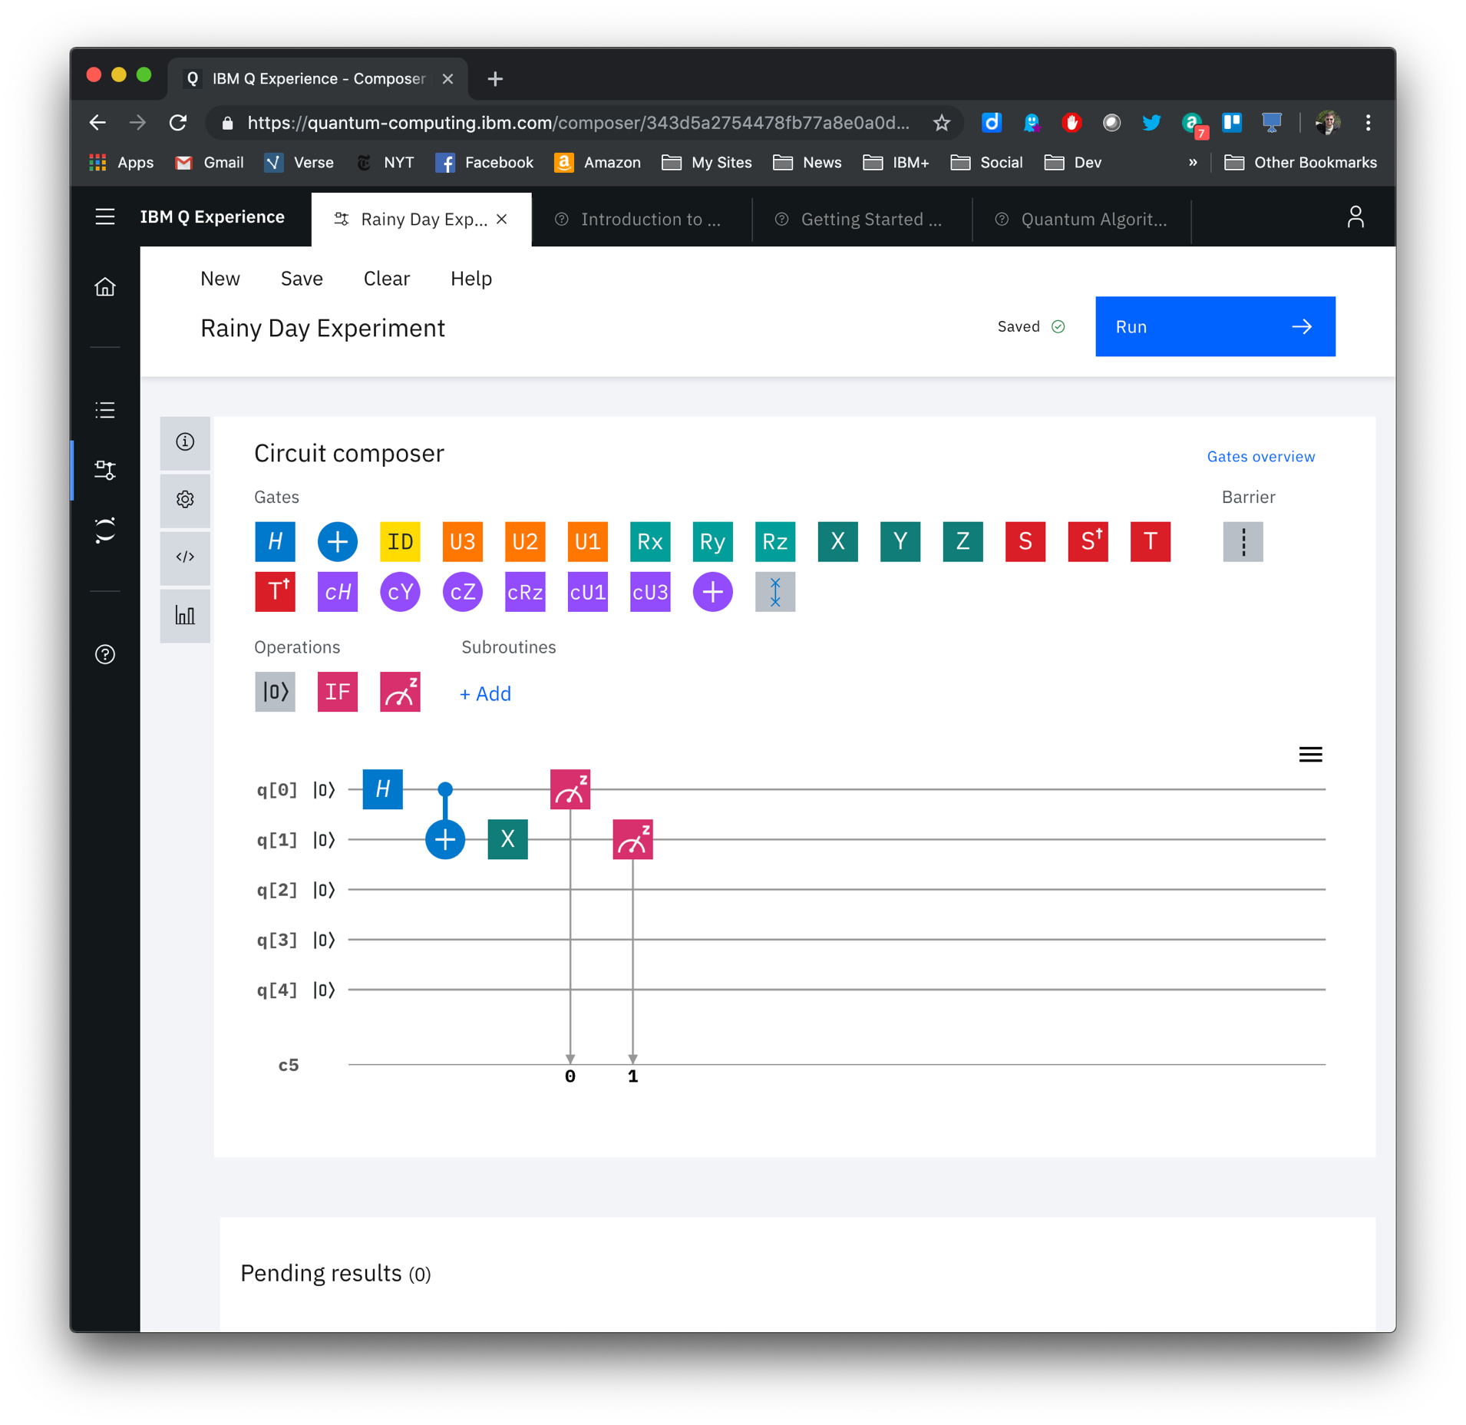
Advanced programming tools for quantum developers
D
A
T₀
Graphically build, debug, and run quantum circuits on IBM Q hardware systems and simulators.

Slide 19
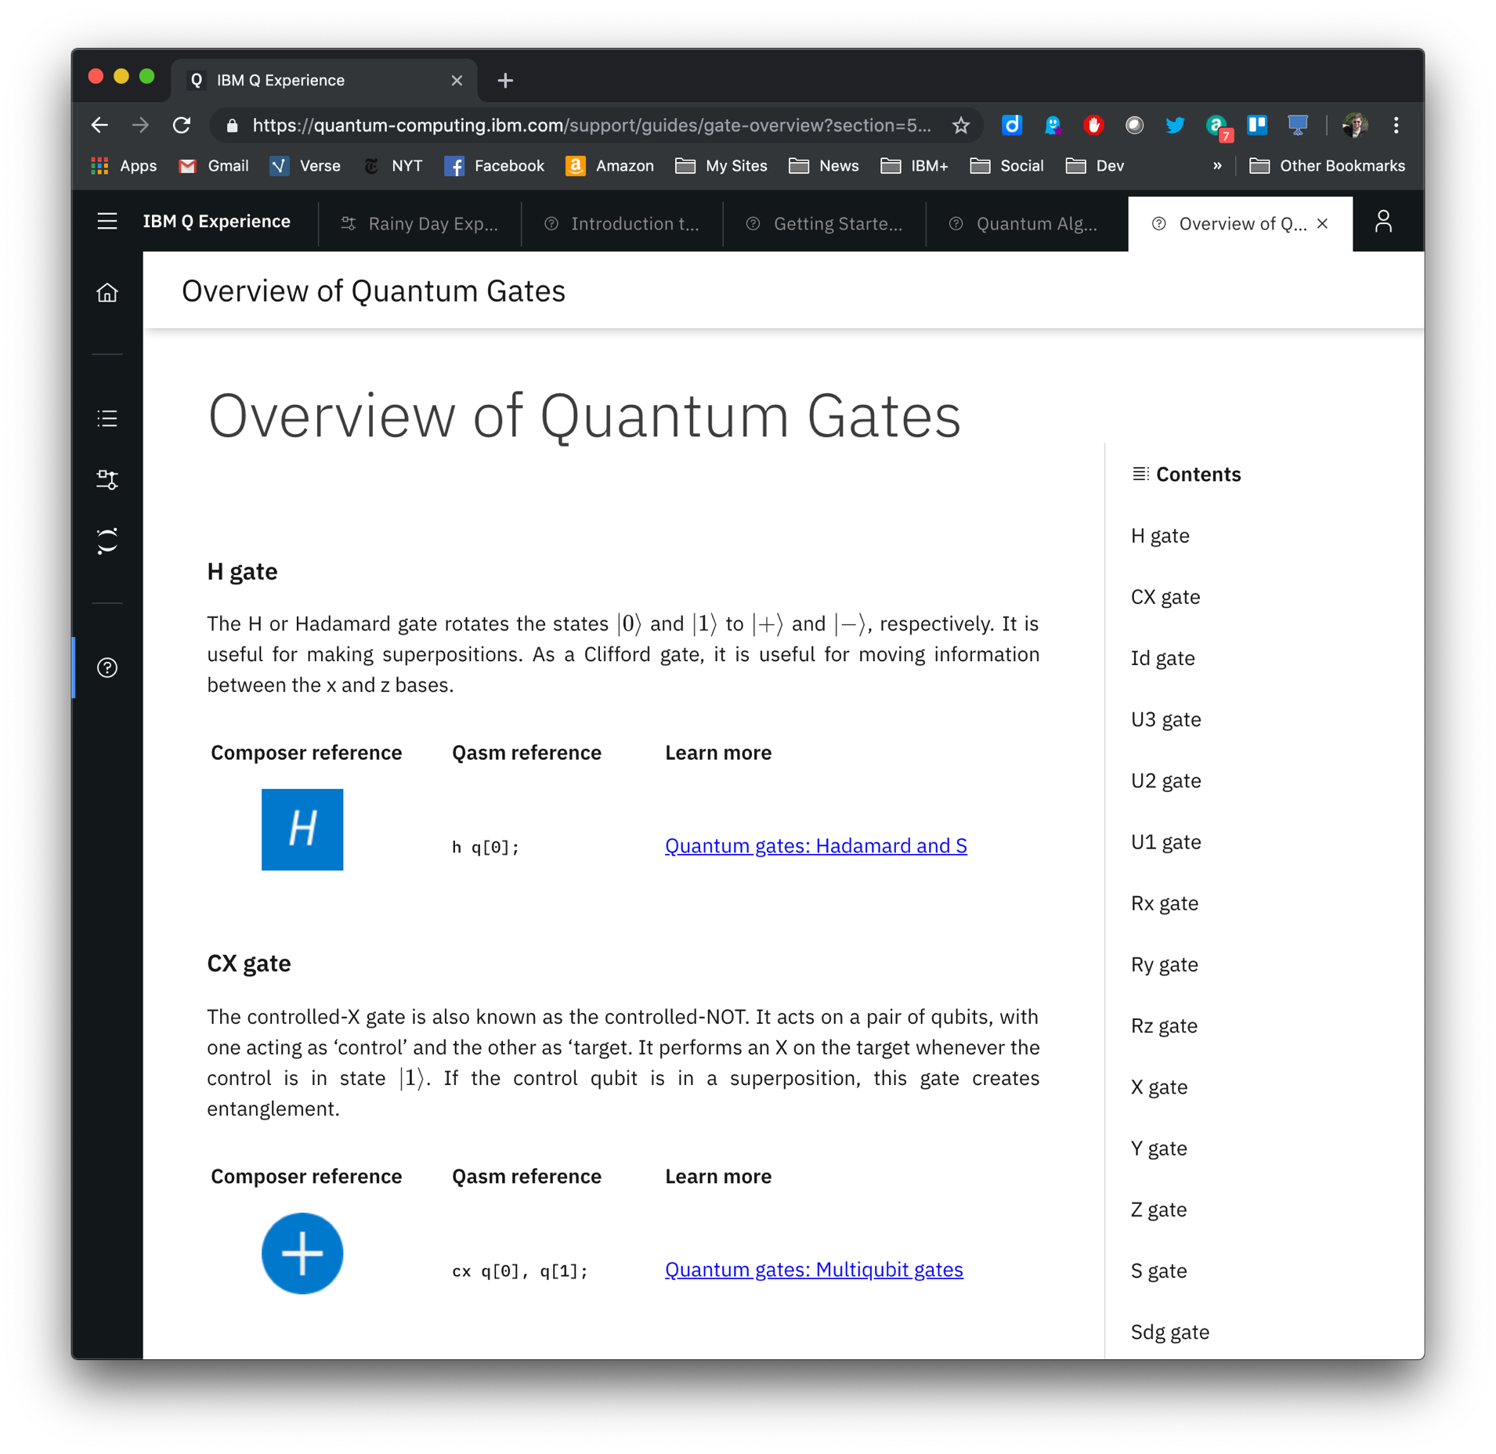
Advanced programming tools for quantum developers
D
A
Use the composer to interactively learn the fundamentals of quantum computing.
T₁

Slide 20
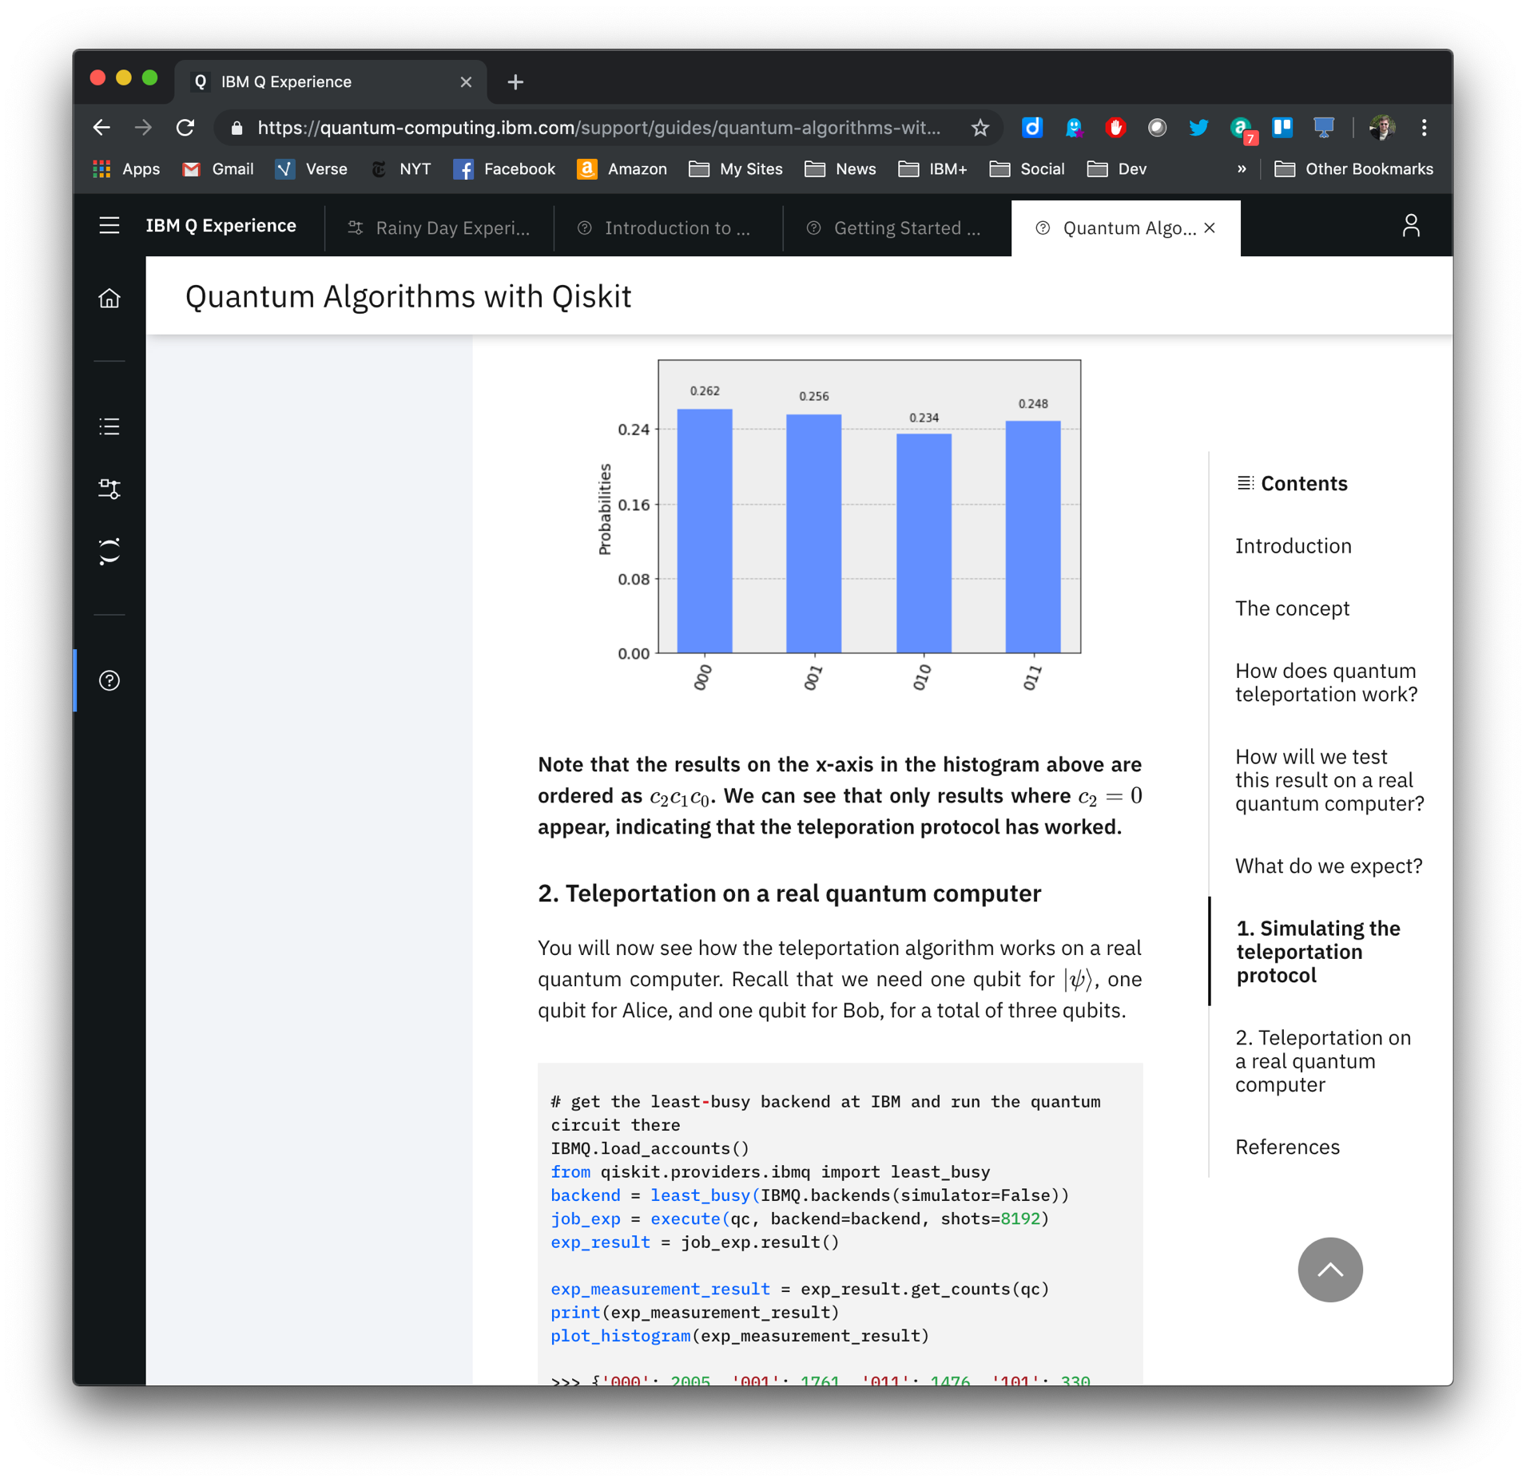
Advanced programming tools for quantum developers
D
A
Programming with Qiskit is seamlessly integrated into the platform – work is saved in the cloud and tools are automatically updated.
T₁

Slide 21
Qiskit Software Stack
Software
Framework and libraries of quantum algorithms that allows users to leverage quantum computing efficiently
D
Brings quantum computing out of the laboratory and into the hands of developers
Open Source (Apache 2.0)
Written in Python 3
Modular and extendible
A
Tools for characterizing
and mitigating error
T₀
Special purpose simulators for algorithm development and quantum research
Foundational tools to build, run and compile quantum circuits
Hardware

Slide 22
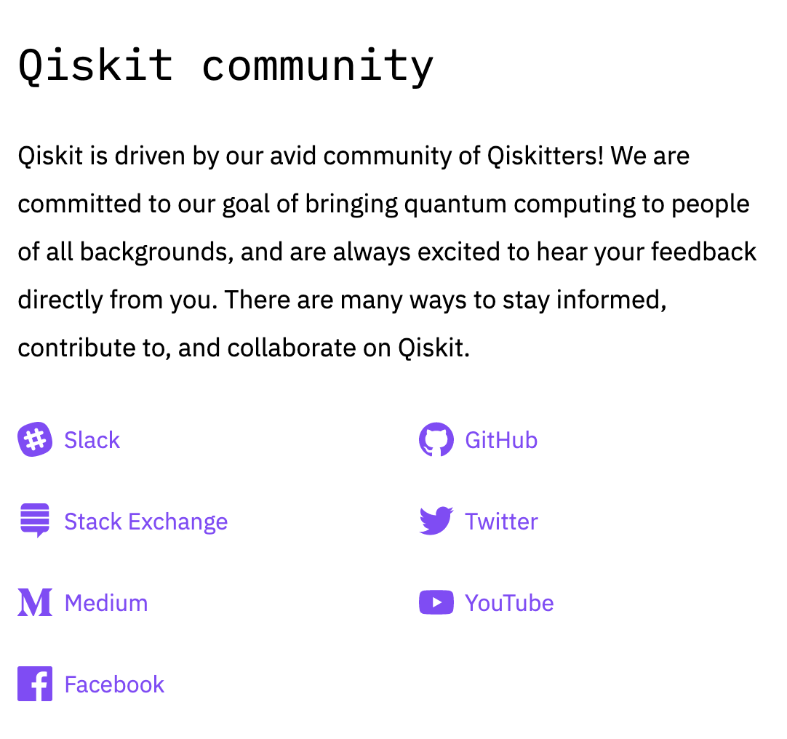
IBM is committed to building the open source community
G
D
Qiskit
A foundation for advancing quantum science with open source tools and capabilities in a modular framework.
A
T₀
IBM Q Experience
Provides quantum cloud services, tools and capabilities optimized for IBM Q systems.

Slide 23
G
IBM Q
ibm.com/ibmq
T₀

Slide 24
G
T₀

Slide 25
IBM Q publications and websites
IBM Q and the IBM Q Experience http://ibm.com/quantum-computing
Qiskit https://qiskit.org
Quantum Volume advancement https://newsroom.ibm.com/2019-03-04-IBM-Achieves-Highest-Quantum-Volume-to-Date-Establishes-Roadmap-for-Reaching-Quantum-Advantage
Open Pulse Development https://arxiv.org/pdf/1809.03452.pdf
Error Mitigation https://www.nature.com/articles/s41586-019-1040-7
A
T₁

Slide 26
IBM Q publications (Chemistry/ML/AI/Finance)
Quantum Chemistry https://www.nature.com/articles/nature23879 https://arxiv.org/abs/1906.10675. (IBM, Keio, and Mitsubishi Chemical)
Quantum Machine Learning https://www.nature.com/articles/s41586-019-0980-2
Quantum AI https://arxiv.org/abs/1906.10467 (Keio, Mitsubishi Chemical, MIzuho, MUFG)
Quantum Finance: Risk analysis https://www.nature.com/articles/s41534-019-0130-6
Quantum Finance: Generative adversarial networks https://arxiv.org/abs/1904.00043
Quantum Finance: Amplitude estimation w/o QPE (IBM, Keio Univ, MUFG and Mizuho joint paper) https://arxiv.org/abs/1904.10246
Quantum Finance: Credit risk analysis https://arxiv.org/abs/1907.03044
Quantum Finance: Option pricing (IBM and JP Morgan Chase joint paper) https://arxiv.org/abs/1905.02666
Quantum Finance: Portfolio optimization https://arxiv.org/abs/1907.04769
Quantum Finance: Qiskit finance https://github.com/Qiskit/qiskit-tutorials/blob/master/qiskit/finance/index.ipynb
A
T₁

Slide 27
IBM Q Expert Insights
B
“Exploring quantum computing use cases for manufacturing” — June 2019 https://www.ibm.com/thought-leadership/institute-business-value/report/quantum-manufacturing
“Getting your financial institution ready for the quantum computing revolution” — April 2019 https://www.ibm.com/downloads/cas/MBZYGRKY
“Building your quantum capability: The case for joining an ecosystem”” — Feb 2019 https://ibm.co/quantumeco
“Coming soon to your business: quantum computing - Five strategies to prepare for the paradigm-shifting technology” ibm.biz/quantumstrategy
“Wielding a double-edged sword: Preparing cybersecurity now for a quantum world” — July 2018 ibm.biz/quantumsecurity
“Taking the Quantum Leap: Why now?” — February 2018 https://www-935.ibm.com/services/us/gbs/thoughtleadership/quantumleap/
T₀

Slide 28
Thank you
G
Michele Grossi
IBMQ Ambassador
Qiskit Advocate
—
michele.grossi@it.ibm.com
+39 344 2320593
T₀
28

